Slide 1


Slide 2
EVENT READY – NOTIFICATION AT YOUR FINGER TIPS
Problem:
There are no real apps available that provide real time notification about various large and specifically small scale adversities like road accidents, road blockage, street fights , fire etc.
People generally has to rely on conventional messaging services which more often than not incur an transmission delay, also some incidents never surface over media and people are ignorant about their occurrences.

Slide 3
SYNOPSIS
WHAT WE HAVE DONE: Is we give the users special privileges to update information about hazardous conditions as and when they come across and broadcast the same to their fellow app users so they can take necessary measures to avoid the situation. Their is no involvement of media and govt. agencies so it cuts delays and results in real time delays.
Another one of our features is, we give the user the facility to search for past disasters and calamities in their desired place and of the desired nature.
We also give real time notification of the air quality and pollution based on the live GPS data.

Slide 4
APIs USED
HP IDOL ON DEMAND – Voice to text conversion
BREEZOMETER – Air quality and pollution notification
RELIEF WEB – Database of past disasters/calamities

Slide 5
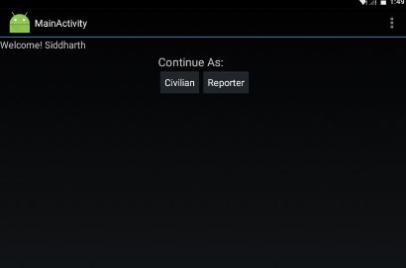
THE PROCESS
There are two ways in which user can use this app, i.e.,
  The Civilian
  The Reporter

Slide 6
THE PROCESS(cont.)
The Citizen has 4 basic facilities of the app :
  He get access to all the broadcasted reports and thus as soon as they are uploaded and can chalk out his activities/route accordingly.
  He has the facility to upvote/downvote the notification based on its authenticity. The more the upvotes, the more is the trust level of the report
  The user gets live feeds and tips regarding air quality levels based on his/her GPS data and will be warned in case he enters a hazardous region.
  The user can also search for the recent calamities or climate/environment related news of any desired location.

Slide 7
As a reporter
User can become a source of information and report small to large scale calamities.
All he have to do is take a photo, add a heading and description and push it to our server. Our server, in turn pushes to all the devices with active app.
For instance, if a user experiences a road blockage due to uprooted tree, he can report it and aware all the users about, thus saving lot of misery.

Slide 8


Camera Taking Pics:

Slide 9
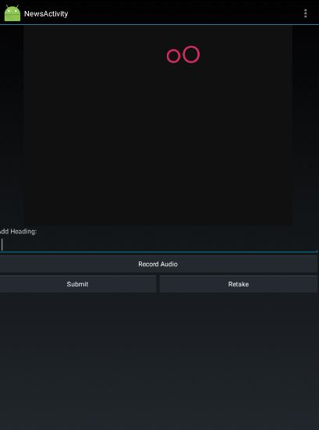
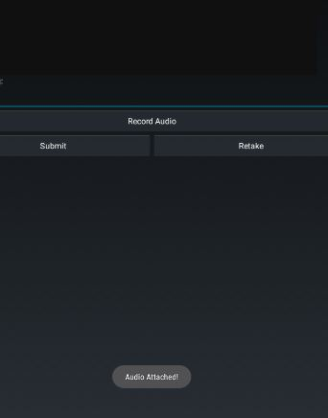
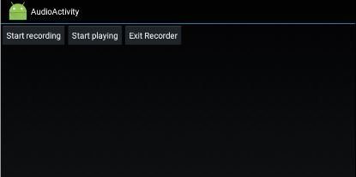
Recording Audio

Slide 10
Where does APIs come in
We have used Hp Idol OnDemmand to convert the audio description to text and then push it to other apps.
We have used ReliefWeb API to get notification and reports of disaster happened around user location.
Breezometer API is used to get air quality around user location.

